Slide 1

INSTITUTE - UIE
DEPARTMENT- ACADEMIC UNITS
Bachelor of Engineering (Computer Science & Engineering)
Subject Name: Elementary Data Structure Using C++
Code:23CSH-103
Sorting
DISCOVER . LEARN . EMPOWER

Slide 2


Elementary Data Structure Using C++
Course Objectives
To enable the students to understand various stages and constructs of C++ programming language.
To improve their ability to analyze and address variety of problems in C++.
To understand the concept of data structures and various operations on them.
To understand the properties of various data structures and able to identify the strengths and weaknesses of different data structures.
To analyze and compare the efficiency of algorithms and learn to design efficient algorithms for solving computing problems

Slide 3



Course Outcomes
CO Number | Course Outcome
CO1 | Understand the concepts of object-oriented programming including programming process and compilation process.
CO2 | Apply different techniques to decompose a problem and programmed a solution with various concepts of object-oriented programming language.
CO3 | Analyse and explain the behaviour of linear data structure operations using the programming addressed in the course.
CO4 | Implement and evaluate the programs using the syntax and semantics of object-oriented programming.
CO5 | Design the solution of real-world problems in order to determine that the program performs as expected.

Slide 4

Scheme of Evaluation

Slide 5
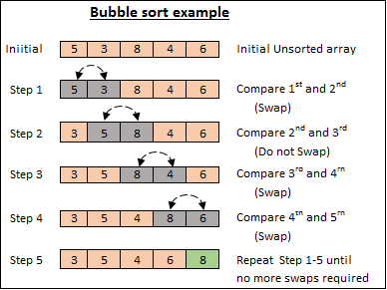
Sorting – Bubble sort
Bubble Sort is a sorting algorithm. It is based on the idea of repeatedly comparing pairs of adjacent elements and then swapping their positions if they show in the wrong order.
Bubble sort, sometimes referred to as sinking sort, is a simple sorting algorithm that repeatedly steps through the list, compares adjacent pairs and swaps them if they are in the wrong order. The pass through the list is repeated until the list is sorted.
Bubble Sort is the simplest sorting algorithm that works by repeatedly swapping the adjacent elements if they are in wrong order
https://medium.com/karuna-sehgal/an-introduction-to-bubble-sort-d85273acfcd8

Slide 6
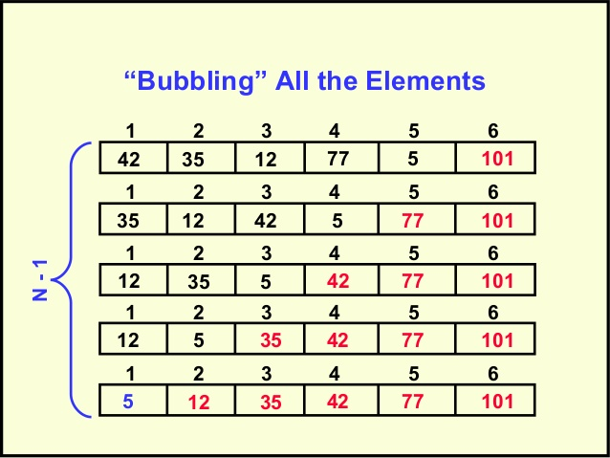
Repeat “Bubble Up” How Many Times?
It uses simple algorithm. It sorts by comparing each pair of adjacent items and swapping them in the order.
This will be repeated until no swaps are needed. The algorithm got its name from the way smaller elements "bubble" to the top of the list.
It is not that much efficient, when a list is having more than a few elements. Among simple sorting algorithms, algorithms like insertion sort are usually considered as more efficient.
Bubble sort is little slower compared to other sorting techniques but it is easy because it deals with only two elements at a time.
www.chegg.com/homework-help/questions-and-answers/matrix-array-vector-rows-data-frame-table-columns-lists-r-data-types-true-true-true-true-f-q28713018

Slide 7
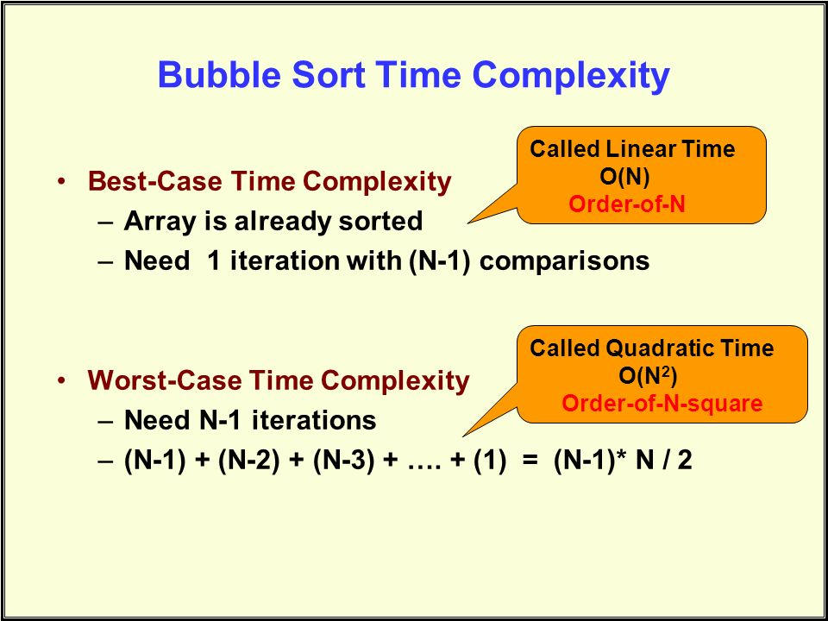
Complexity of the bubble sort algorithm
The space complexity for Bubble Sort is O(1), because only a single additional memory space is required i.e. for temp variable. Also, the best case time complexity will be O(n), when the list is already sorted.
To calculate the complexity of the bubble sort algorithm, it is useful to determine how many comparisons each loop performs.
For each element in the array, bubble sort does n−1 comparisons. In big O notation, bubble sort performs O(n) comparisons.
https://slideplayer.com/slide/8414999/

Slide 8
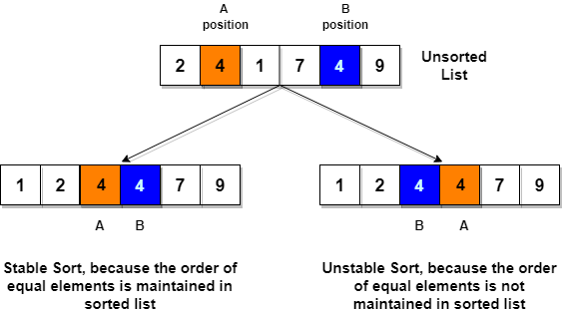
Algorithm for Insertion Sort
.
It is efficient for smaller data sets, but very inefficient for larger lists.
Insertion Sort is adaptive, that means it reduces its total number of steps if a partially sorted array is provided as input, making it efficient.
It is better than Selection Sort and Bubble Sort algorithms.
Its space complexity is less. Like bubble Sort, insertion sort also requires a single additional memory space.
It is a stable sorting technique, as it does not change the relative order of elements which are equal.
https://www.studytonight.com/data-structures/insertion-sorting

Slide 9
Complexity Analysis of the Insertion sort Algorithm
The worst case performance occurs when the elements of the input array are in descending order. In that case, the first pass requires 1 comparison, the 2nd pass requires 2 comparisons , and kth element requires (k-1) and finally the last pass requires (n-1) comparisons. Therefore, total no. of comparisons in case of descending order(worst case) is:
F(n)= 1+2+3….+(n-1)
=n(n-1)/2 = O(n2 )
Total number of comparisons in case of ascending order (best case) is: (n-1) comparisons
i.e. f(n)=O(n) .

Slide 10
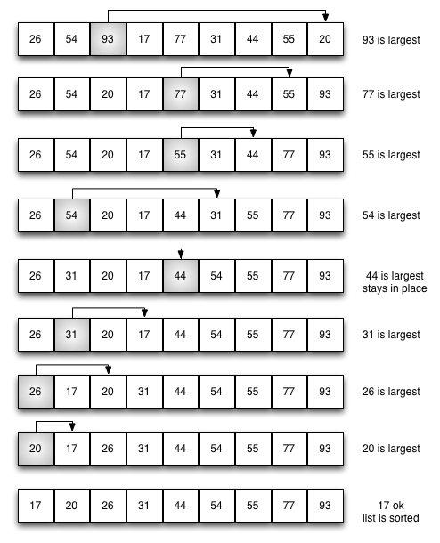
Algorithm for Selection Sort
.
The selection sort improves on the bubble sort by making only one exchange for every pass through the list. In order to do this, a selection sort looks for the largest value as it makes a pass and, after completing the pass, places it in the proper location.
As with a bubble sort, after the first pass, the largest item is in the correct place.
After the second pass, the next largest is in place. This process continues and requires n−1n−1 passes to sort n items, since the final item must be in place after the (n−1)(n−1) st pass.
https://interactivepython.org/courselib/static/pythonds/SortSearch/TheSelectionSort.html

Slide 11
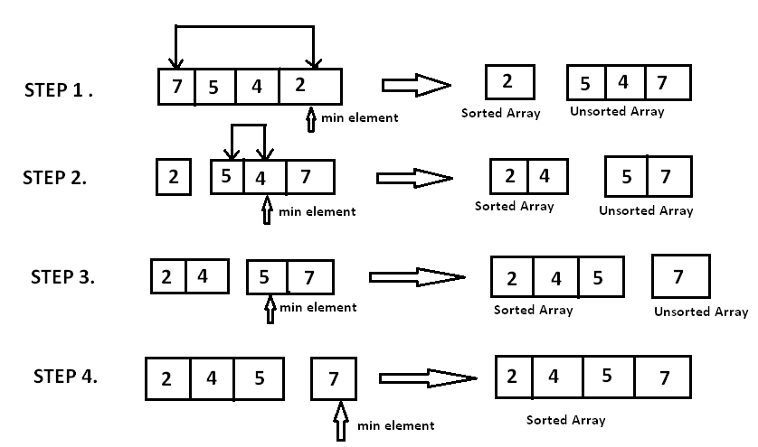
Example Selection Sort
.
The Selection sort algorithm is based on the idea of finding the minimum or maximum element in an unsorted array and then putting it in its correct position in a sorted array.
Assume that the array A=[7,5,4,2] needs to be sorted in ascending order.
The minimum element in the array i.e. 2 is searched for and then swapped with the element that is currently located at the first position, i.e. 7.
Now the minimum element in the remaining unsorted array is searched for and put in the second position, and so on.
https://www.hackerearth.com/practice/algorithms/sorting/selection-sort/tutorial/

Slide 12
Complexity of the Selection sort algorithm
Number of comparisons in the selection sort algorithm is independent of the original order of the elements. N-1 comparisons required during pass1 to find the smallest element, n-2 in 2nd pass and so on.
f(n) =(n-1)+(n-2)+…..2+1= n(n-1)/2 = O(n2 )

Slide 13
Applications
Searching
Closest pairs
Element uniqueness
Frequency distribution
Selection

Slide 14
REFERENCES
Lipschutz, Seymour, “Data Structures”, Schaum's Outline Series, Tata McGraw Hill.
Goodrich, Michael T., Tamassia, Roberto, and Mount, David M., “Data Structures and Algorithms in C++”, Wiley Student Edition.
https://www.tutorialspoint.com/data_structures_algorithms/sorting_algorithms.htm
https://www.geeksforgeeks.org/sorting-algorithms/
Lipschutz, Seymour, “Data Structures”, Schaum's Outline Series, Tata McGraw Hill.
Gilberg/Forouzan,” Data Structure with C ,Cengage Learning.
Augenstein,Moshe J , Tanenbaum, Aaron M, “Data Structures using C and C++”, Prentice Hall of India.

Slide 15
THANK YOU

